Slide 1
Exploring the Fundamentals of Digital Imagery: Pixels, Resolution, Color Models, and Bit Depth

Slide 2
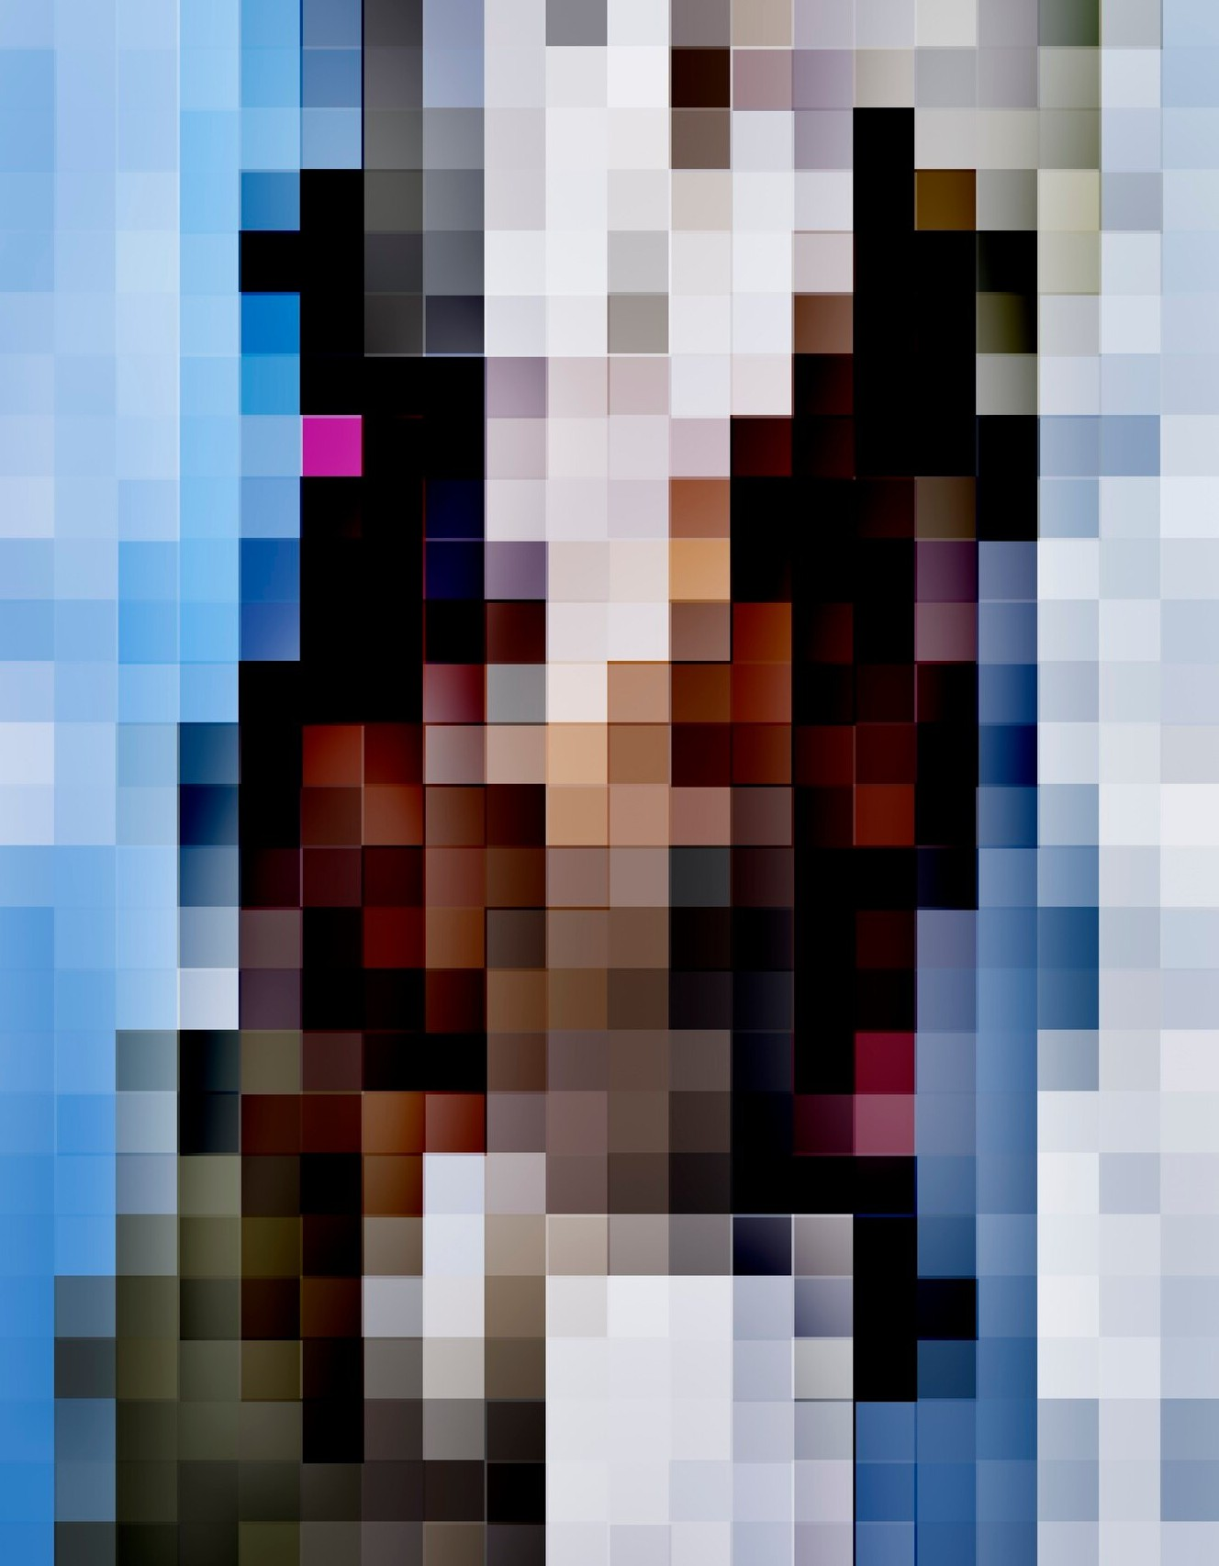
Exploring Digital Imagery Fundamentals
Discover the core concepts of digital imagery, including a
pixels,resolution and color models.
Understand how these elements work together to create the digital
images we encounter daily.

Slide 3
Understanding Pixels and Resolution
Explore the basic building blocks of digital imagery -pixels. Learn how the number and density of pixels, or resolution, impact the quality and clarity of digital images.

Slide 4
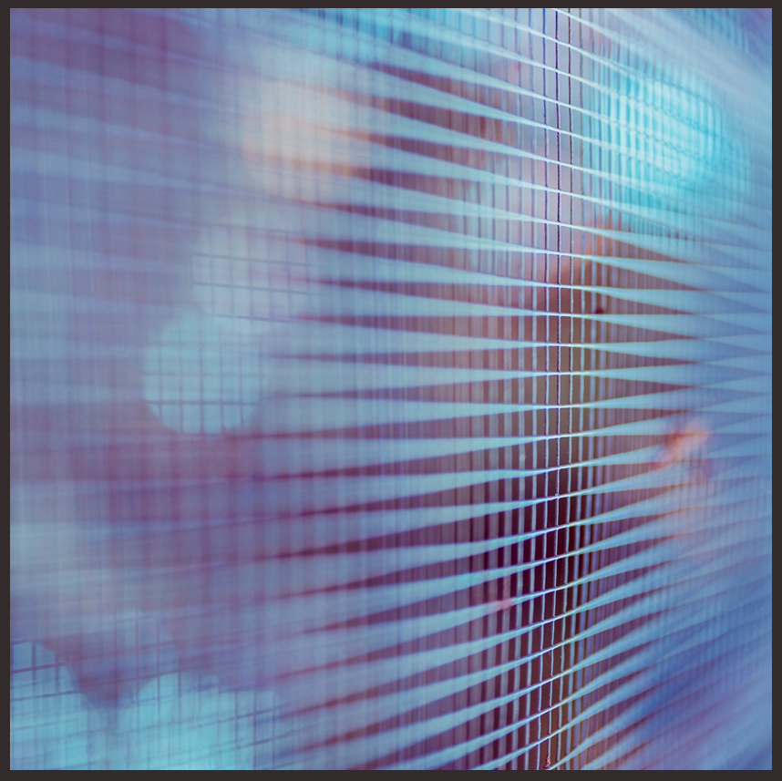
Understanding Pixels and Resolution
Understand the importance of selecting the appropriate resolution for your needs.

Slide 5
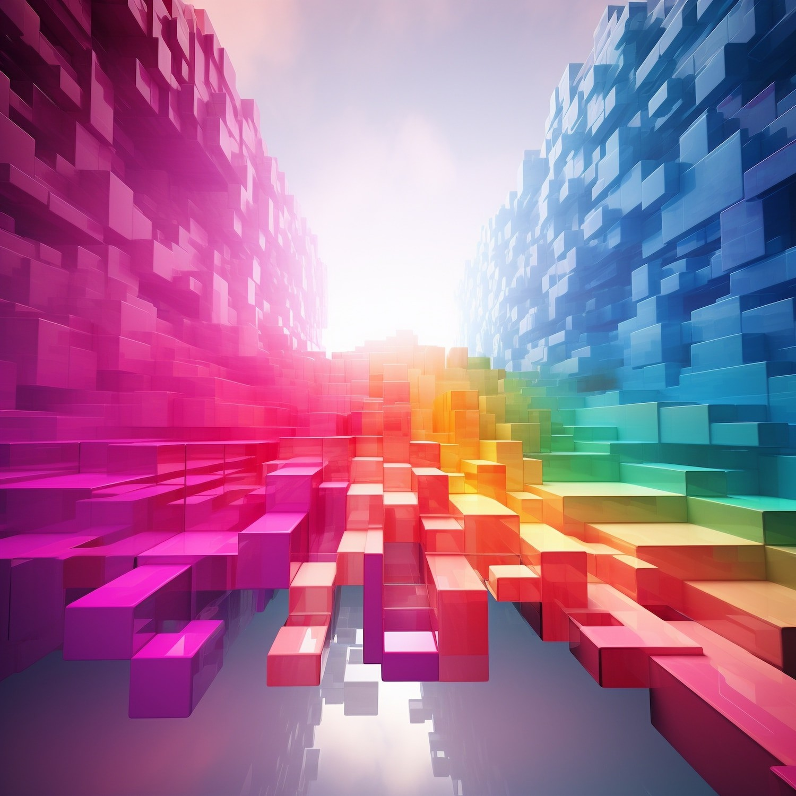
Exploring Color Models and Bit Depth
Delve into the world of color models, such as RGB and CMYK, and how they represent the vast spectrum of colors in digital images. Understand bit depth, which determines the number of colors an image can display, and its impact on image quality and ﬁle size.

Slide 6
Conclusion: Mastering Digital Imagery
In summary, the fundamental concepts of pixels , r e s o l u t io n ,c o l o r m o d e l s , and bit depth are the building blocks of digital
imagery.

Slide 7
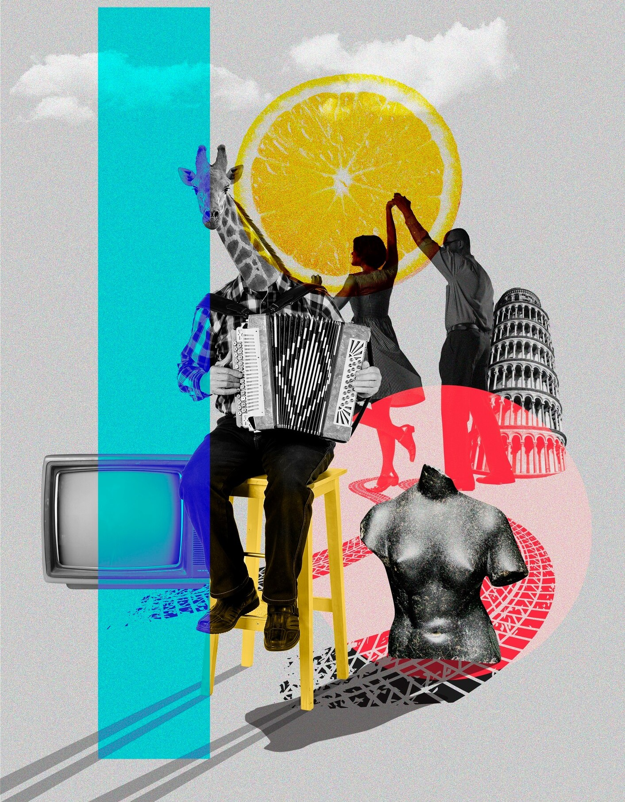
Conclusion: Mastering Digital Imagery
By understanding these elements, you can create, manipulate, and optimize digital images for various applications and industries.

Slide 8
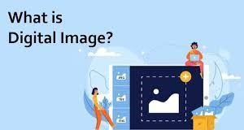
Digital Images
A digital image is a representation of a two-dimensional visual object in a digital format. It is composed of pixels (in the case of raster images) or paths defined by mathematical equations (in the case of vector images).

Slide 9
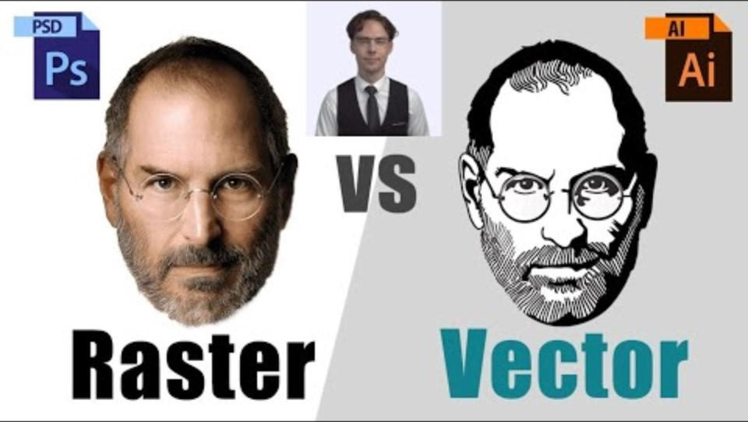
Image Types
Raster Images:
Pixel-based
Resolution-dependent
Suitable for detailed and complex images
Vector Images:
Path-based
Resolution-independent
Suitable for images with sharp edges and flat colors

Slide 10
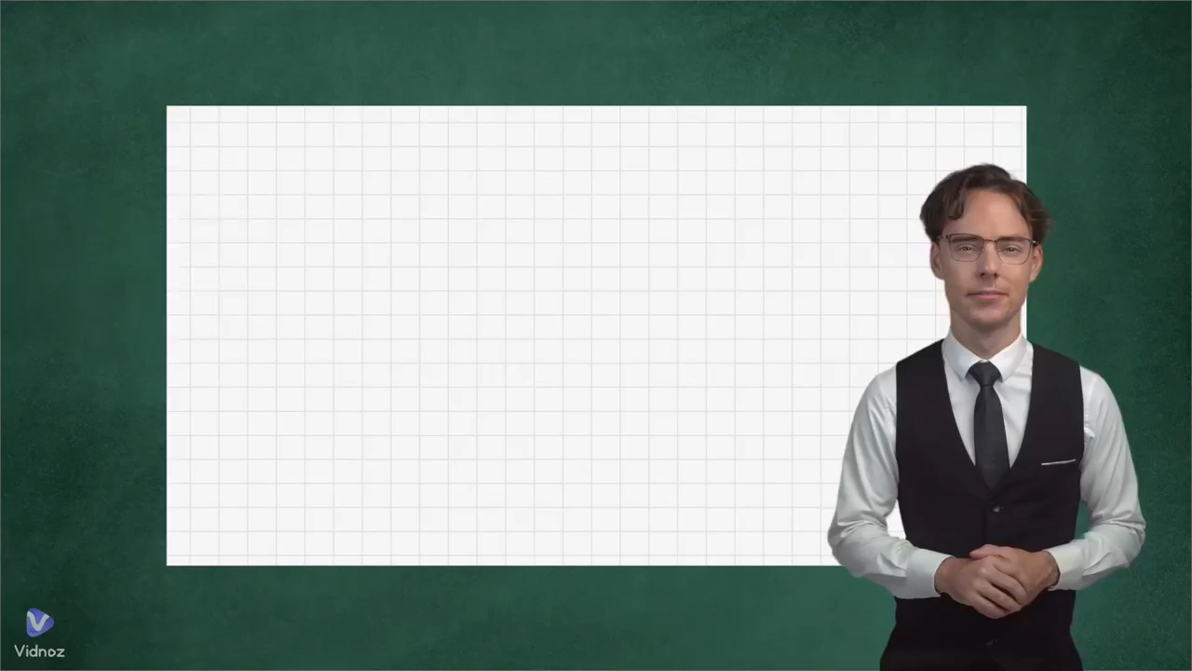

Slide 11
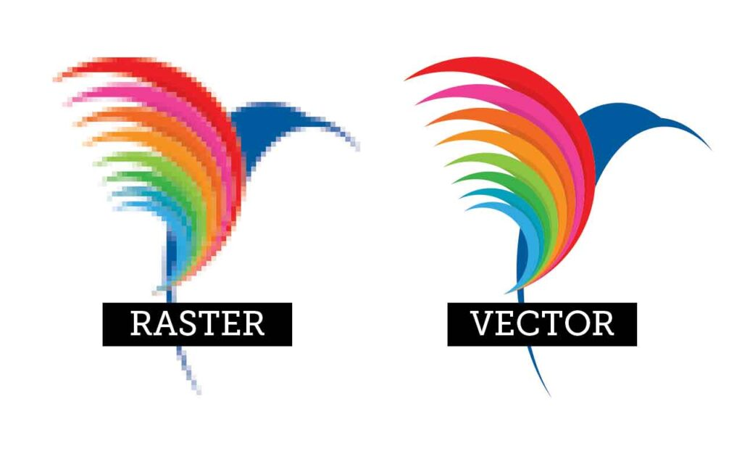
Difference on Characteristics of Images
Raster Images
Vector Images
Composed of pixels in a grid.
Resolution-dependent; quality degrades when scaled up.
Composed of paths defined by mathematical equations.
Resolution-independent; quality remains consistent when scaled up.

Slide 12
Difference on Common Formats Images
Raster Images
Vector Images
JPEG (Joint Photographic Experts Group): Commonly used for photographs and images with many colors and gradients.
PNG (Portable Network Graphics): Supports lossless compression and transparency.
SVG (Scalable Vector Graphics): XML-based format for web use. Supports interactivity and animation.
PDF (Portable Document Format): Can contain both vector and raster data. Commonly used for documents and graphics.

Slide 13
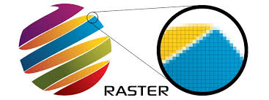
Raster Images
Raster images, also known as bitmap images, are composed of individual pixels. Each pixel has a specific color value and position within the grid that forms the image.

Slide 14
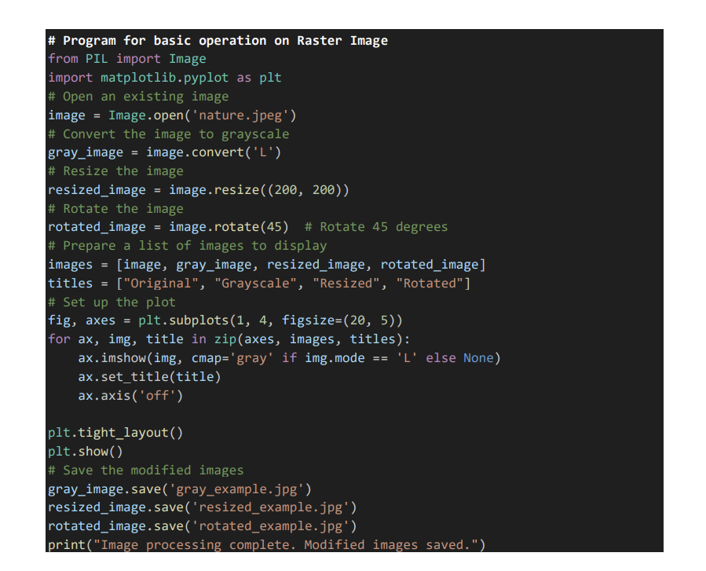
Raster Program
This Python code performs basic
Image processing operations using
the PIL (Pillow) and matplotlib
libraries. It begins by opening
an existing image file named
nature.jpeg. The code then
converts this image to grayscale,
resizes it to 200x200 pixels, and
rotates it by 45 degrees. These
modified images , along with the
original image, are
stored in a list.

Slide 15
Raster Program
The images are then displayed in a
single row using matplotlib with
titles "Original", "Grayscale",
"Resized", and "Rotated" to
indicate their respective
transformations. The display is
formatted to fit tightly within the
plotting window. After displaying
the images, the grayscale, resized,
and rotated versions are saved as
gray_example.jpg,
resized_example.jpg, and
rotated_example.jpg, respectively.

Slide 16
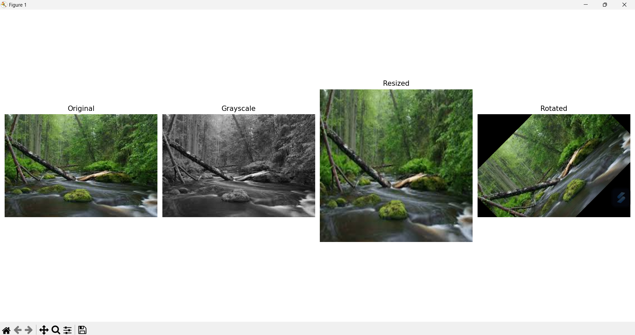
Basic Function Raster Output

Slide 17

Vector Images
A vector image is a type of digital graphic that is created using mathematical equations rather than individual pixels.

Slide 18
Vector Images
Vector images are composed of paths defined by a start and end point, along with other points, curves, and angles. These paths can create simple or complex shapes and are scalable to any size without losing quality or clarity.

Slide 19
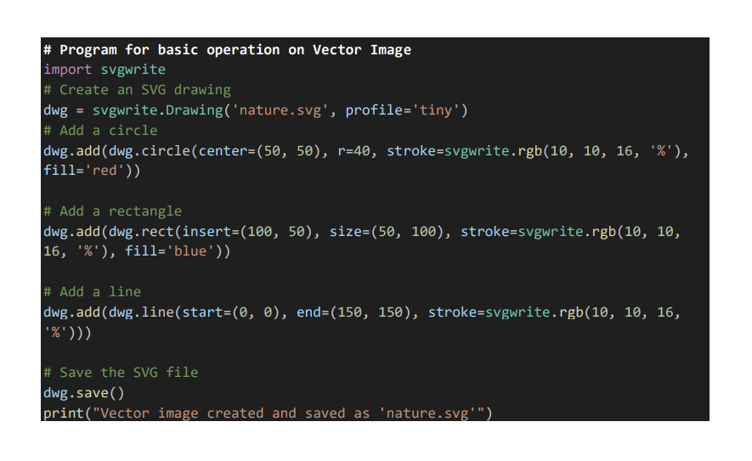
Vector Program
This Python code utilizes the
svgwrite library to create a simple
vector image in SVG (Scalable
Vector Graphics) format. It begins
with nature.svg then adds three
basic shapes to the drawing: a red
circle centered at (50, 50) with a
radius of 40 pixels, a blue rectangle
positioned at (100, 50) with
dimensions 50x100 pixels, and a
line drawn from the coordinates (0,
0) to (150, 150), all with specified
stroke colors.

Slide 20
Vector Program
Each shape is added to the SVG
drawing using svgwrite methods
such as add(), circle(), rect(), and
line(). Finally, the drawing is saved
to the file nature.svg, and a
confirmation message is printed to
indicate the successful creation and
saving of the vector image. This
code demonstrates the basic use of
vector graphics to create scalable
and easily editable shapes, suitable
for various applications such as
web graphics and illustrations.

Slide 21
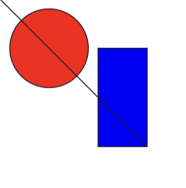
Basic Function Vector Output

Slide 22
Conclusion
Raster Images:
Pixel-based
Resolution-dependent
Suitable for detailed and complex images
Common formats: JPEG, PNG, BMP, GIF
Vector Images:
Path-based (mathematical equations)
Resolution-independent
Suitable for images with sharp edges and flat colors
Common formats: SVG, EPS, PDF

